Slide 1
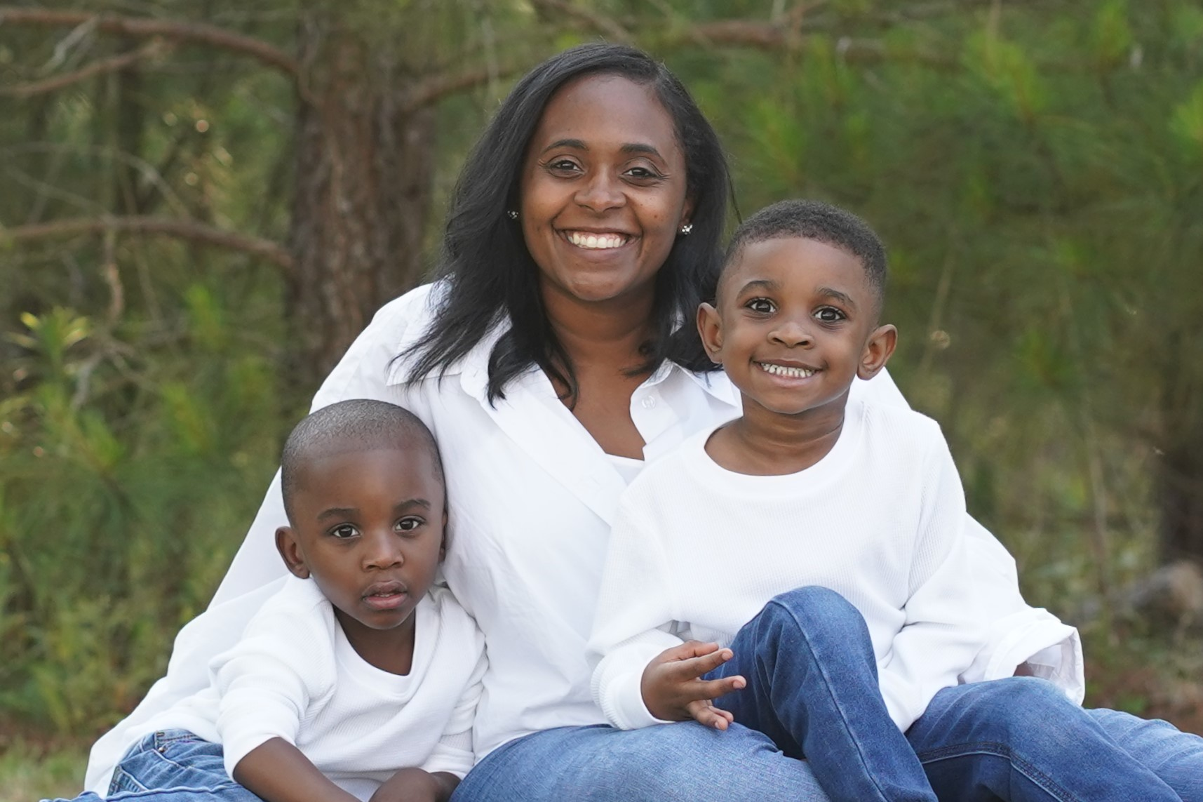
Meet your Teacher
Ms. Butler
Welcome Parents and Students! I am so excited to be your teacher for this upcoming school year. This is my 2nd year of teaching. I have 2 children, Grayson and Garrison. They are 4 and 3.
I love spending time with
family/friends
I love to sing
I have 2 jobs
I love to read
I love dogs
I l love traveling
I
Food: Japanese Food
Color: Coral
Place: Hawaii
Store: Target
Music: Gospel
Movie: Hairspray
Animal: Dog
Drink: Mellow Yellow

